Slide 1
Where to expand business?
Coursera Capstone
Scott Kurihara

Slide 2
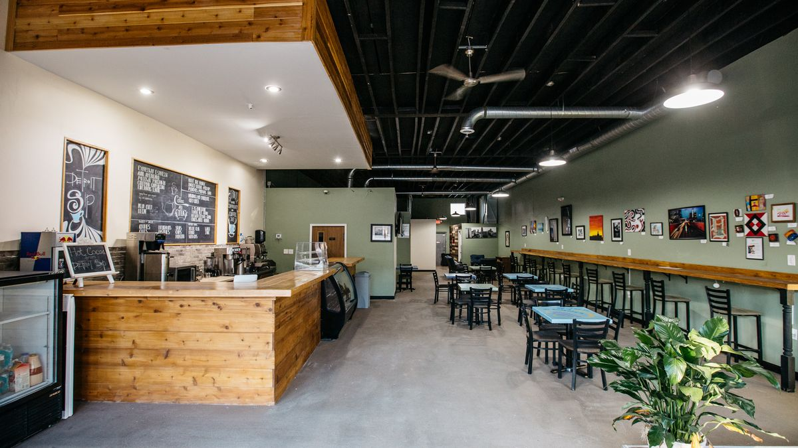
Business Problem
An owner of a cofffee shop in Flagstaff, AZ would like to expand his business. He is looking to open a coffee shop in a town similar to Flagstaff, AZ which is a college town.

Slide 3

Top 50 College Towns to live in
http://www.collegeranker.com/features/best-college-towns/
Using this list as a basis to find similar college towns to Flagstaff, AZ

Slide 4
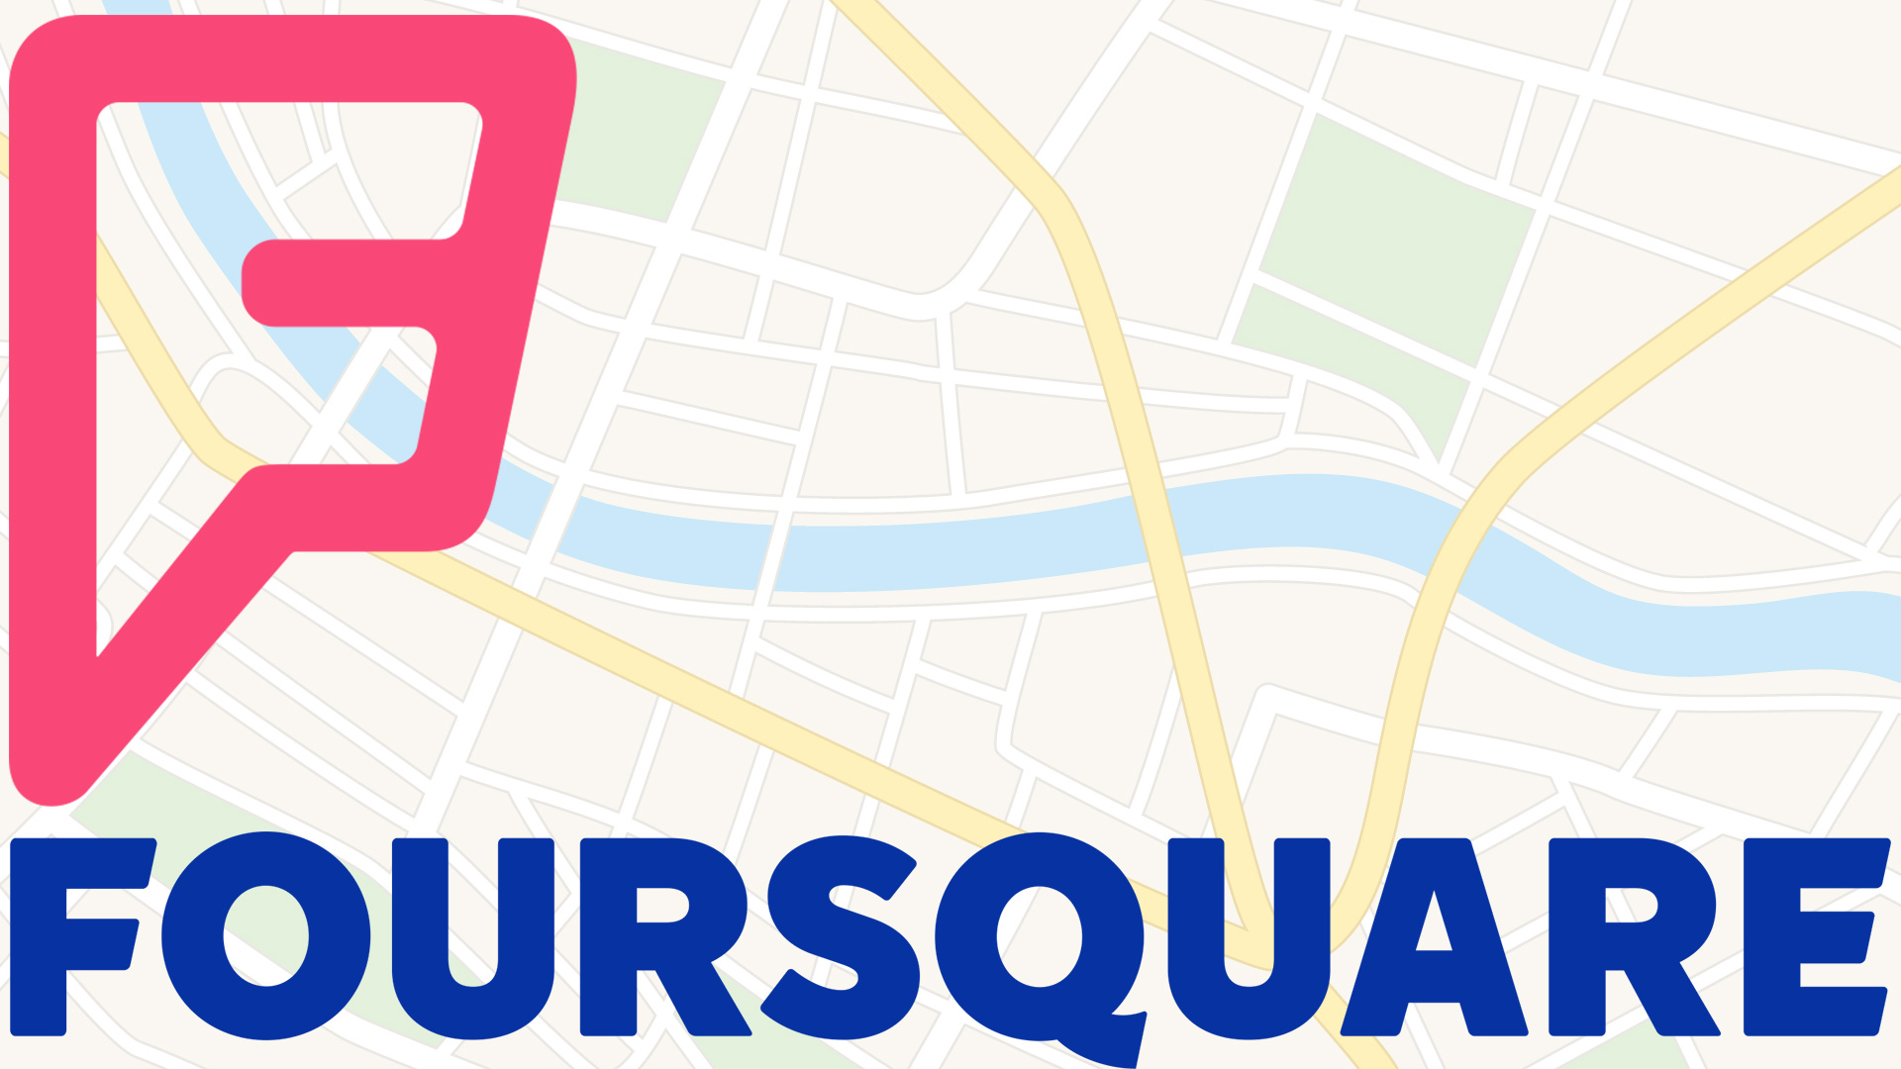
FourSquare API
Used FourSquare API
Got the top 100 venues per town using the Explore API

Slide 5
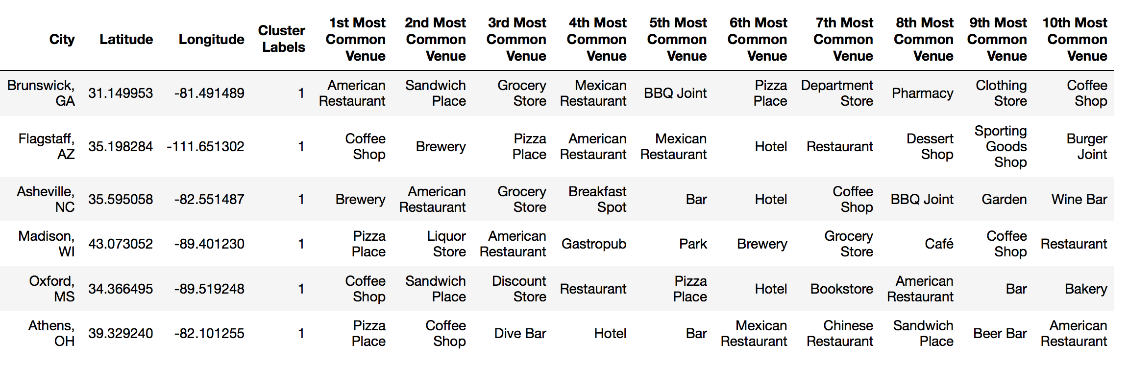
Results
Using Kmeans Clustering Algorithm, this is the cluster that contained Flagstaff, AZ.
There are 5 cities similar to Flagstaff, AZ
Shows the Top 10 Most Common Venues

Slide 6
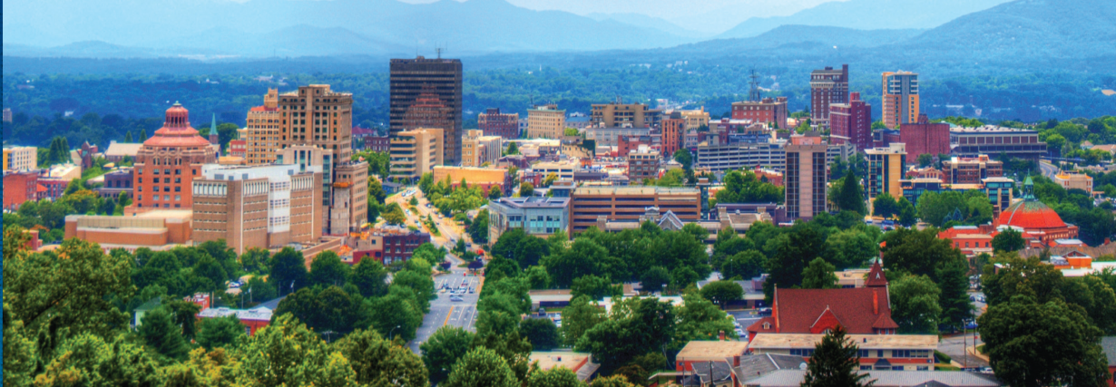
Asheville, NC
Out of the 5 similar cities, Asheville, North Carolina, was the only city that did not have a coffee shop in the Top 10 most common venues.

Slide 7
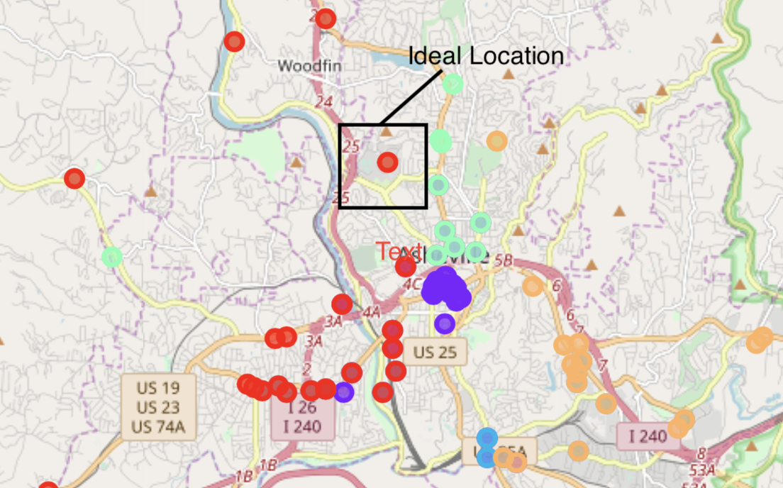
Recommendation
After analyzing the map, I would recommend that the business owner open a coffee shop in the ideal location box shown above.
This is right near the University of North Caroline, Asheville. It would be somewhere in between 28004 and 28006.

Slide 8
Conclusion
I would recommend opening a business in Asheville, NC.
More specifically in either zip code 28004 or 28006.
Opening a coffee shop in zip code 28004 or 28006 would be a location that is near the University of North Carolina, Asheville but also away from competition.
If there was an oppurunity to apply more research before picking a place to open a coffee shop, I would reccomend using a clustering technique on the top 50 college towns by demographics. That would provide you an oppurtunity to find a town that has the target audience of you coffee shop.

